Slide 1
Microsoft Azure Workshop
Welcome
David.Gristwood@microsoft.com,
Mark.Bloodworth@microsoft.com
Bianca Furtuna bifurt@microsoft.com
Jonathan Collinge jocollin@microsoft.com
Kevin.Lief@microsoft.com
Richard Conway richard@elastacloud.com & Andy Cross andy@elastacloud.com
#UKDXAzure

Slide 2
Agenda
10:00 AM Workshop starts, with breaks for coffee and lunch
2:00 PM Data Masterclass
4:30 PM Informal networking and close
Welcome and Azure overview
Devices and connecting to the cloud
Microservices and containerisation in Azure
Internet of Things with Azure
Microsoft Bot Framework
Commercial update
Data Masterclass with Elastacloud

Slide 3
Microsoft Azure
The cloud platform
built for business and
innovation

Slide 4
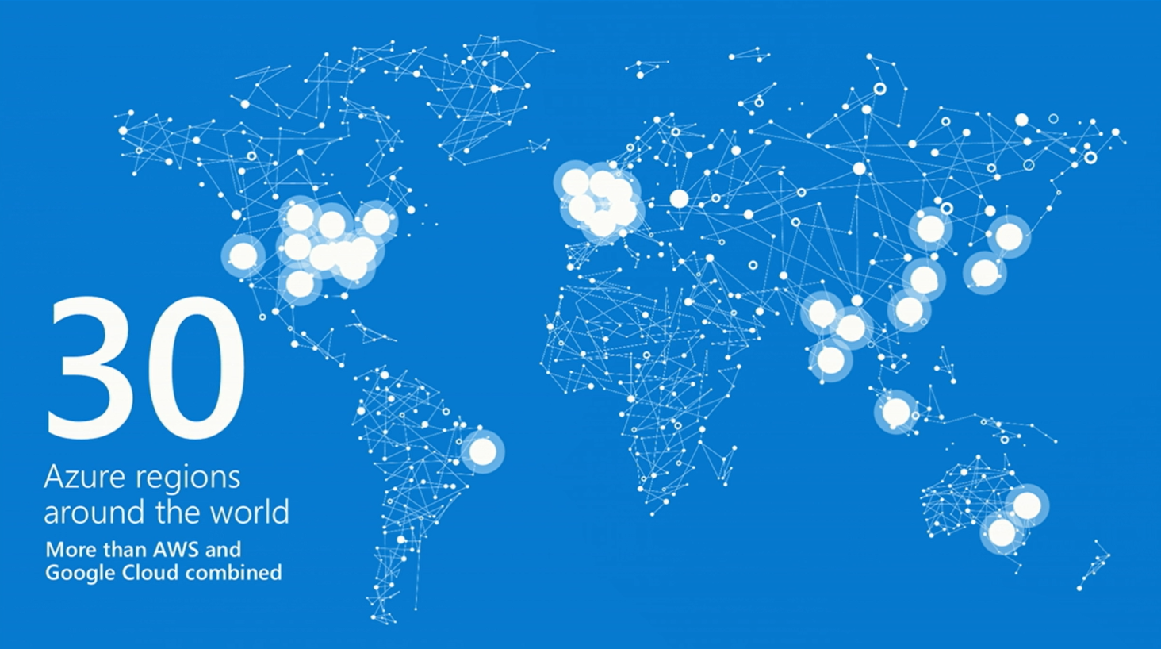

Slide 5
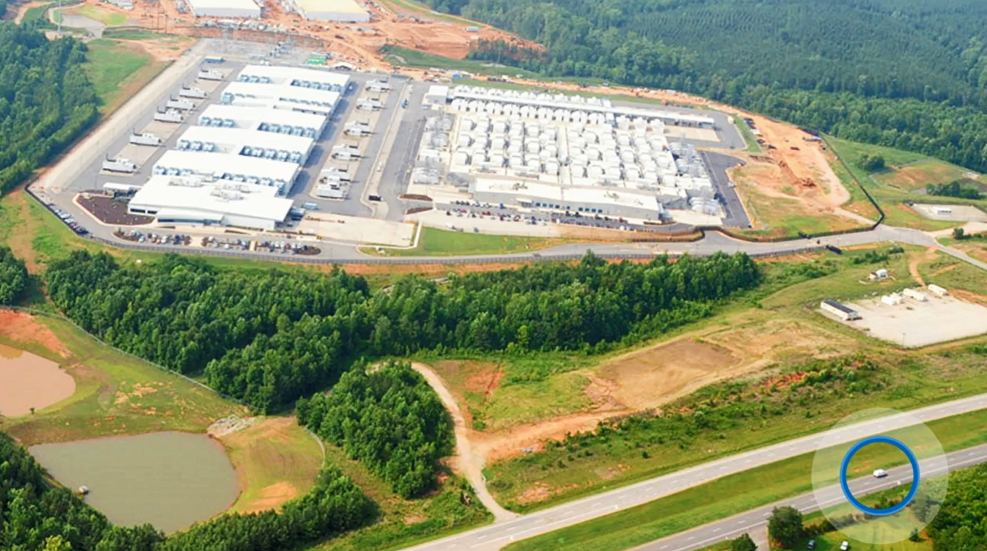

Slide 6
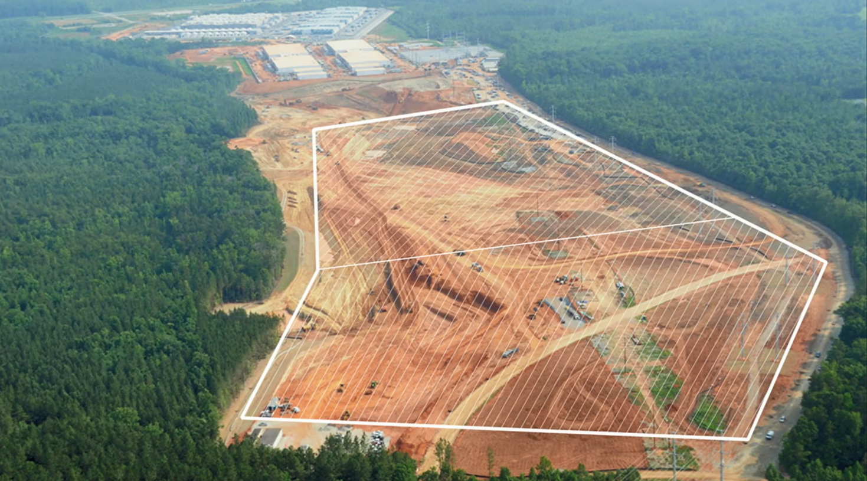

Slide 7
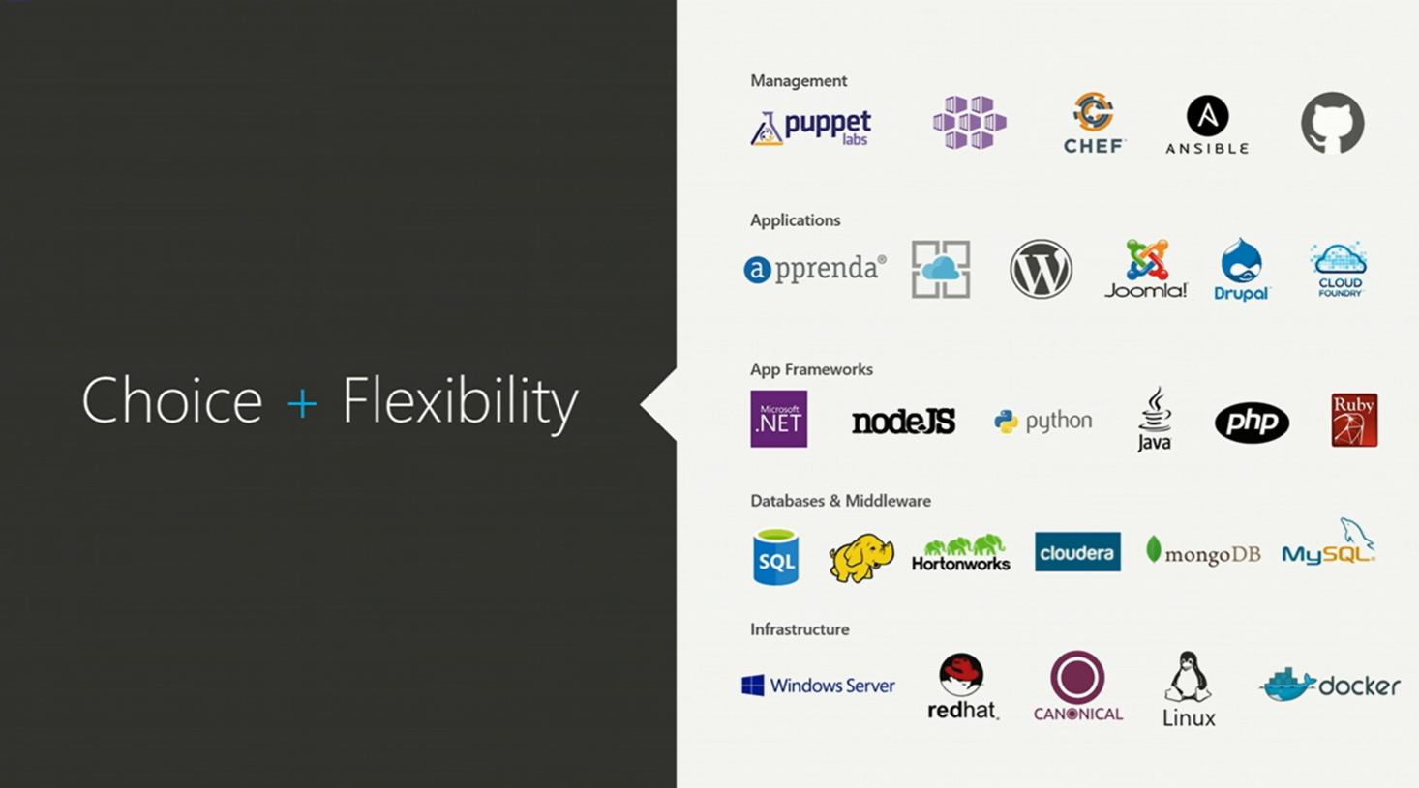

Slide 8
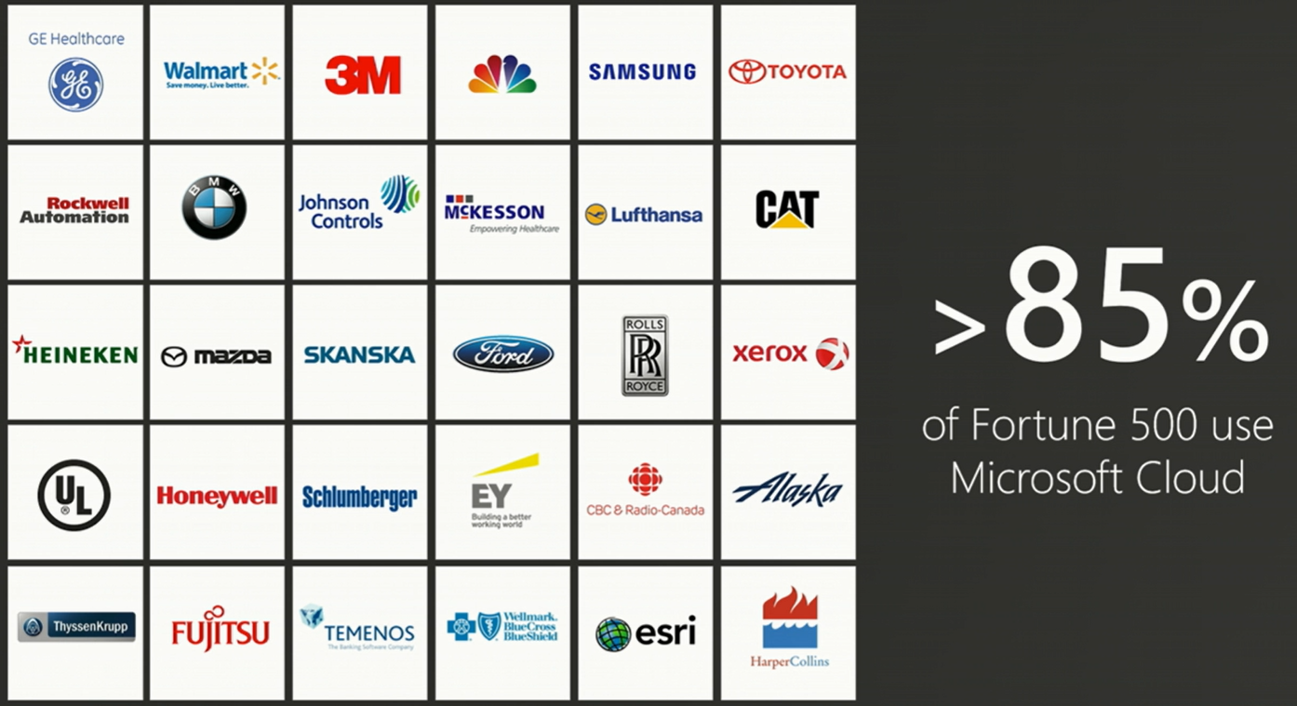

Slide 9
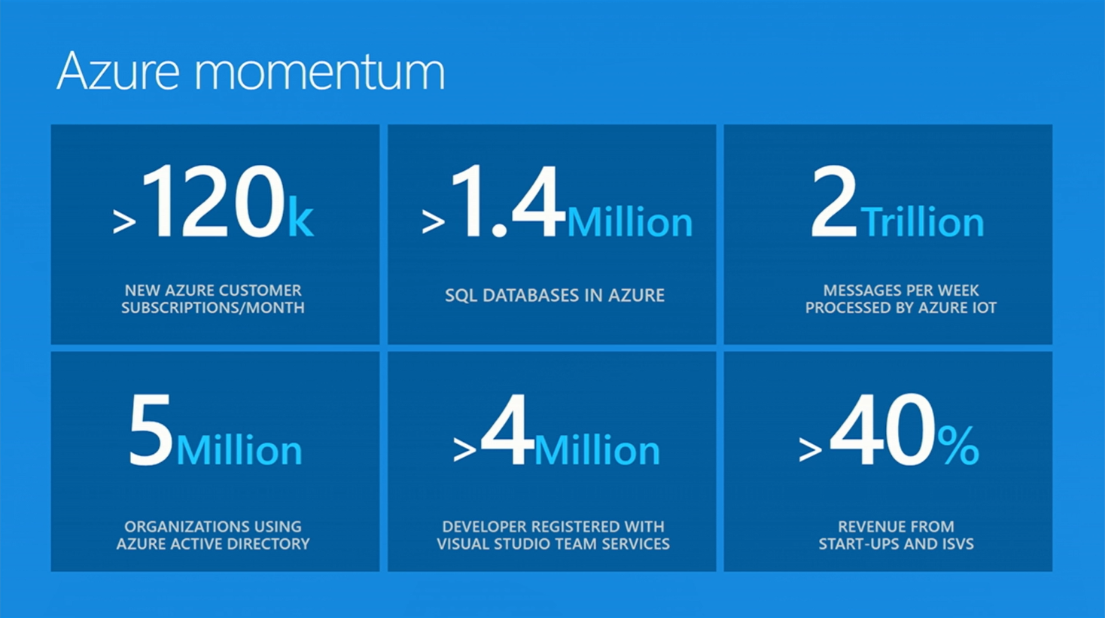

Slide 10




















































Platform Services
Security & Management
Compute
Web and Mobile
Developer Services
Hybrid
Operations
Cloud
Services
Service
Fabric
Web Apps
API
Apps
API
Management
Visual Studio
Azure SDK
Portal
Azure AD
Connect Health
Batch
Remote App
Mobile
Apps
Logic
Apps
Notification
Hubs
Team Project
Application
Insights
Active
Directory
AD Privileged
Identity
Management
Multi-Factor
Authentication
Integration
Analytics & IoT
Data
Backup
Storage
Queues
Biztalk
Services
Automation
HDInsight
Machine
Learning
SQL
Database
SQL Data
Warehouse
Operational
Insights
Hybrid
Connections
Service
Bus
Key Vault
Data
Factory
IoT and Event
Hubs
Redis
Cache
Search
Import/Export
Store /
Marketplace
Media & CDN
Site
Recovery
Stream
Analytics
Mobile
Engagement
DocumentDB
Tables
VM Image Gallery
& VM Depot
Media
Services
Content Delivery
Network (CDN)
StorSimple
Infrastructure Services
Compute
Storage
Networking
Virtual Machines
Containers
BLOB Storage
Azure Files
Premium Storage
Virtual Network
Load Balancer
DNS
Express
Route
Traffic Manager
VPN Gateway
Application Gateway
Datacenter Infrastructure (24 Regions, 19 Online)

Slide 11
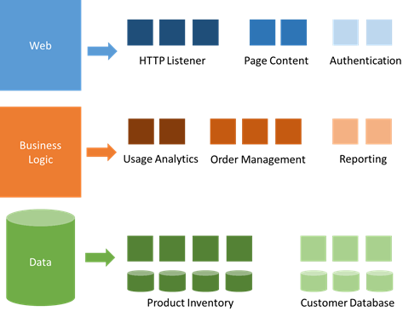
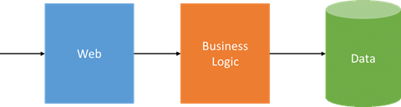
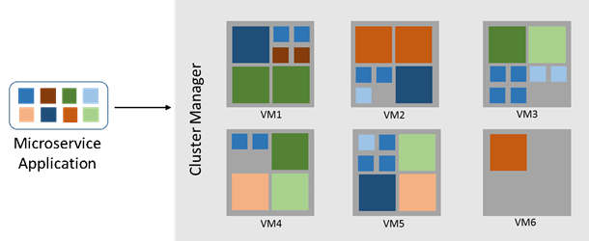
Move to Microservices
Microservices
Three-Tier Monolithic Application
Decompose to services small enough to truly reflect independent concerns
Containerization separates application from underlying infrastructure
Cluster manager maximizes overall resource utilization
Microservices can scale and update independently
Notes:
https://azure.microsoft.com/en-us/blog/microservices-an-application-revolution-powered-by-the-cloud/

Slide 12
Containerization and Microservices with Azure
Azure Functions
compute-on-demand
Azure Service Fabric
microservices framework
Azure Container Service
orchestration and composition
Azure Virtual Machine Scale Sets
flexible infrastructure
Notes:
https://azure.microsoft.com/en-us/blog/microservices-an-application-revolution-powered-by-the-cloud/
https://azure.microsoft.com/en-gb/services/container-service/

Slide 13
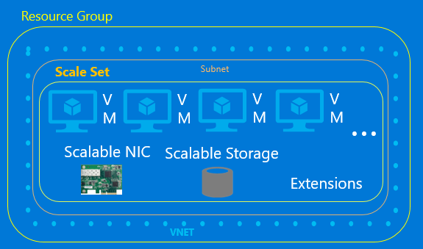
Azure Virtual Machine Scale Sets “Control it like IaaS, scale it like PaaS”
GA at //build
Deploy and manage identical virtual machines as a set
Integrated auto-scale and load balancing
Define a single compute resource, which has network, storage and extension properties

Slide 14

Azure Functions “Functions as a service”
Preview at //build
Event driven, compute-on-demand
Storage, queues, messages, HTTP triggers
Makes it easy to process and react to events
Scale-based and on-demand, so pay only for the resources you consume
“Serverless” execution model
Built on Web Jobs SDK, Run in App Services

Slide 15
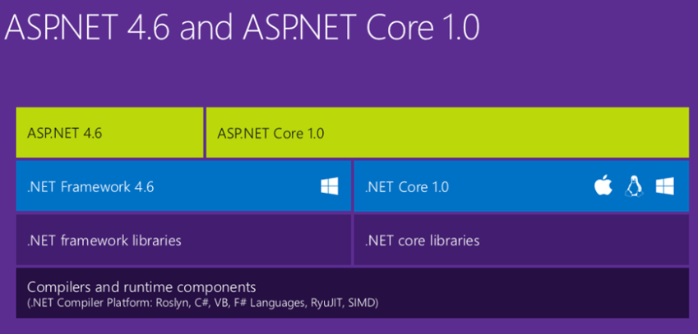
ASP.NET 5 is dead – Long Live ASP.NET Core 1.0 and .NET Core 1.0
ASP.NET 4.6 is the more mature platform, it’s battle-tested and released and available today
ASP.NET Core 1.0 is a 1.0 release that includes Web API and MVC and EF but doesn’t yet have SignalR or Web Pages, or VB or F# support
“There are only two hard things in Computer Science: cache invalidation and naming things” - Phil Karlton
Notes:
https://blogs.msdn.microsoft.com/webdev/2016/01/19/asp-net-5-is-dead-introducing-asp-net-core-1-0-and-net-core-1-0/

Slide 16

SQL Database

